Slide 1
Software Presentation
Group 7

Slide 2
Group Dynamics
Each member of the group has suggested ideas and improvements throughout the ongoing weeks.
Luke – Set up Github platform, programmed artefact
Darius – Pair programming logs, Programmed artefact
Hayden – Programmed artefact
Savannah – Product backlog, sprint planning, user stories, presentation
Caitlin – Product backlog, sprint planning, sprint backlog, user stories
Jackson – UI

Slide 3
User Stories
As a < type of user >, I want < some goal > so that < some reason >.
As a user I want to authorise my account without any errors so that I can access Spotify’s news related playlists.
As a user I want to read the article related to the song on the playlist
As a user I want a user friendly, easy and efficient GUI so that my experience is pleasant and enjoyable.
As a user I want to be able to download my news related playlist to listen offline

Slide 4
Product Backlog -Feature required for Spotify -Product backlog placed in correct sequence – Value/Cost/Knowledge/Risk NOT FINISHED
ID | Product Backlog Item | Sprint Points | Business Value | Priority
1 | As a user I want to authorise my account without any errors so that I can access Spotify’s news related playlists. |  |  | 1
2 | Create a playlist that’s relating the new headlines of the day |  |  | 2
3 | As a user I would like a user friendly, easy and efficient GUI so that my experience is pleasant and enjoyable. |  |  | 3
4 | Saving the playlist to the users account |  |  | 4
5 | As a user I want to read the article related to the song on the playlist |  |  | 5
6 | As a user I would like to be able to download my news related playlist to listen offline |  |  | 6

Slide 5
Sprint Planning Sprint Planning is the subset of the product backlog During sprint planning the team have agreed on a sprint goal
Product Backlog ID | Product – To do | Outcome – What to Achieve
1 | As a user I want to authorise my account without any errors so that I can access Spotify’s news related playlists. | For the user to be-able to log in to their account with having any errors For the user to be able to sign up
2 | Create a playlist that’s relating the new headlines of the day | Program Spotify to create daily playlist relating the news headlines
3 | As a user I would like a user friendly, easy and efficient GUI so that my experience is pleasant and enjoyable. | To create a UI that the clients can use which is efficient and is user friendly.
4 | Saving the playlist to the users account | For the clients to be able to save the playlist to their individual user account.
5 | As a user I want to read the article related to the song on the playlist | Program Spotify to be able to give you the link to be able to read an article relating the headlines
6 | As a user I would like to be able to download my news related playlist to listen offline | To program Spotify making sure the clients/ customers able to download the playlist

Slide 6
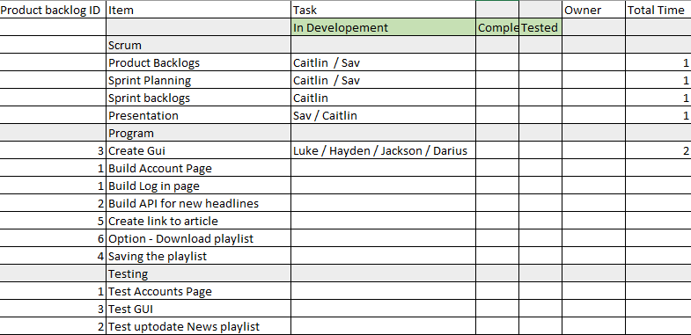
Sprint Backlog Sprint Backlog is a list a task identified by the scrum team

Slide 7
Tools and Toolsets
As a group, we have used the github platform to upload pieces of work which contributes to the overall assignment.
We have also used Draw.io to create any diagrams required throughout.
Visual studio

Slide 8
Evaluation

Slide 9
Thank you

